Slide 1
Electrostatics

Slide 2
Electrostatics
Coulomb’s Law
Electrical field due to any charge configuration
Gauss’s Law
Charge distribution is symmetrical
“Assume the electric field is in a vacuum or free space”

Slide 3
Coulomb’s Law
Coulomb’s law is the “law of action” between charged bodies.
Coulomb’s law gives the electric force between two point charges in an empty universe.
A point charge is a charge that occupies a region of space which is negligibly small compared to the distance between the point charge and any other object.

Slide 5
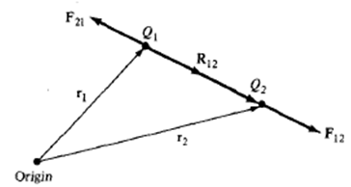



Coulomb’s Law
It states that the force F between two point charges Q₁ and Q₂ is directly proportional to the product of the charges and inversely proportional to the square of the distance joining these charges.
In vector form;
Or
If we have more than two point charges; The Principal of superposition

Slide 6


Electric Field Intensity
The electric field describes the effect of a stationary charge on other charges and is an abstract “action-at-a-distance” concept, very similar to the concept of a gravity field.
The basic units of electric field are Newton's per Coulomb.
In practice, we usually use volts per meter.
Electric Field Intensity is the force per unit charge when placed in the Electric Field
In vector form;
If we have more than two point charges; The Principal of superposition

Slide 7
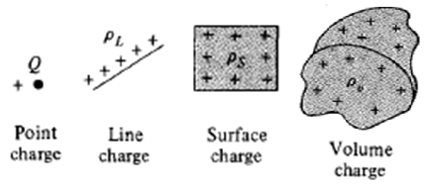



Electric Field Intensity
Electric Field due to Continuous Charge Distribution
If there is a continuous charge; distribution say along a line, on a surface, or in a volume
The charge element dQ and the total charge Q due to these charge Distributions can obtained by;

Slide 8



Electric Field due to Continuous Charge Distribution
The electric field intensity due to each charge distribution ρ_{L}, ρ_{S} and ρ_{V} may be given by the summation of the field contributed by the numerous point charges making up the charge distribution.

Slide 9
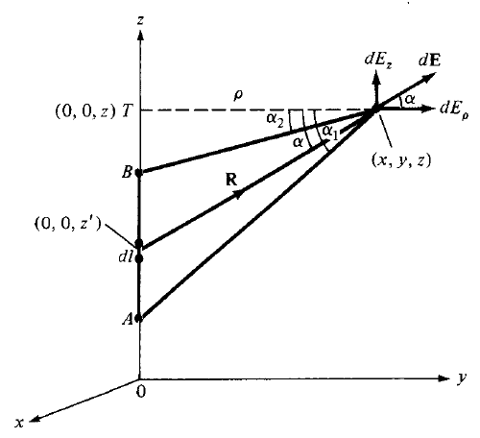




A Line Charge
Consider a line charge with uniform charge density ρ_{L} extending from A to B along the z-axis.
The charge element dQ associated with element dl = dz of the line is
The total charge Q is
The electric field intensity E at an arbitrary point P (x, y, z) can be given by
The field point is generally denoted by (x, y, z) and the source point as (x’, y’, z’). So from fig…

Slide 10





Electric Field Intensity due to Line Charge
Further R may be written as;
Hence intensity equation becomes

Slide 11


Electric Field Intensity due to Line Charge
To evaluate this, we should define α, α₁ and α₂ as in given fig. ;
From triangle TPdl; Secα = R / ρ so R = ρ Secα or, ρ = R Cosα
or
Further; From triangle TPdl;
tanα = z-z’ / ρ
So, z-z’ = ρ tanα
or, z’ = z - ρ tanα
or, z’ = OT - ρ tanα
or, dz’ = - ρ sec²α d α
putting these values in last equ.

Slide 12



Electric Field Intensity due to Line Charge
Or,
So for a finite line charge, we have;
So as a special case, for an finite line charge, if point B is at (0,0,∞) and A is at (0,0,-∞). Then α₁ = π/2 and α₂ = -π/2. So z-component will vanish then we have;

Slide 13
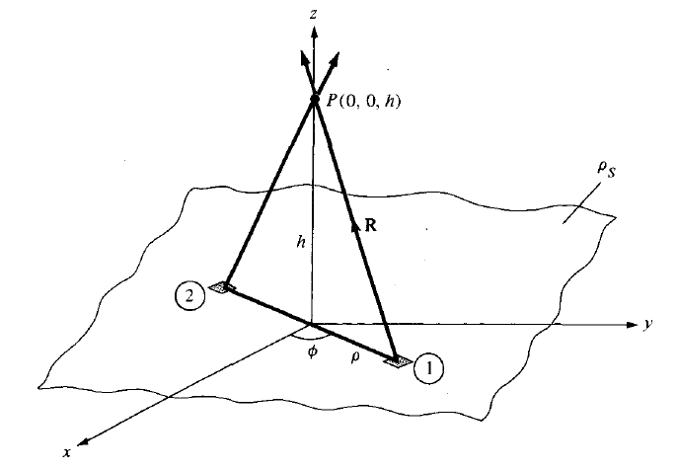


Electric Field Intensity due to Surface Charge
Consider an infinite sheet of charge in the xy plane with uniform charge density ρ_{S}. The charge associated with an elemental area dS is
And hence total charge is
The contribution to Electric Field at Point P (0, 0, h) by the elemental surface is

Slide 14





Electric Field Intensity due to Surface Charge
Substitution of these terms in Electric Field equation gives

Slide 15




Electric Field Intensity due to Surface Charge
Due to the symmetry of charge distribution, for every element 1, there is a corresponding element 2 whose contribution along a_{ρ} cancels that of element 1.
So E has only z-component
In general for an infinite sheet of charge

Slide 16

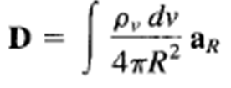
Electric Flux Density
The electric field intensity depends on the medium in which the
charges are placed.
Suppose a vector field D independent of the medium
is defined by
The electric flux ψ in terms of D can be defined as
The vector field D is called the electric flux density and is
measured in coulombs per square meter.
For an infinite sheet the electric field intensity D is given by
For a volume charge distribution the electric field intensity
D is given by
In both the above equations D is a function of charge and position only (independent of medium)

Slide 17
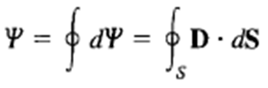


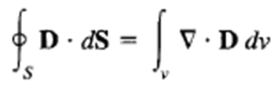
Gauss Law
It states that the total electric flux ψ through any closed surface
is equal to the total charge enclosed by that surface.
Using Divergence Theorem
Comparing the two volume integrals
This is the first Maxwell’s equation.
It states that the volume charge density is the same as the divergence of the electric flux density.

Slide 18


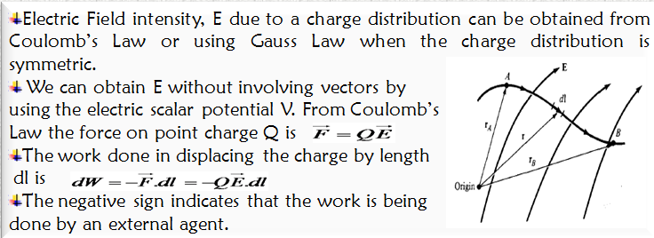
Electric Potential
The potential at any point due to a point charge Q
located at the origin is
The potential at any point is the potential difference between that point and a chosen point at which the potential is zero.
Assuming zero potential at infinity, the potential at a distance r from the point charge is the work done per unit charge by an external agent in transferring a test charge from infinity to that point.

Slide 19
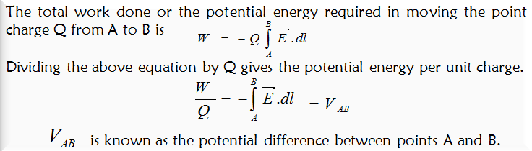
Electric Potential
If V_{AB} is negative, there is loss in potential energy in moving Q from A to B (work is being done by the field), if V_{AB} is positive, there is a gain in potential energy in the movement (an external agent does the work).
It is independent of the path taken. It is measured in Joules per Coulomb referred as Volt.

Slide 20
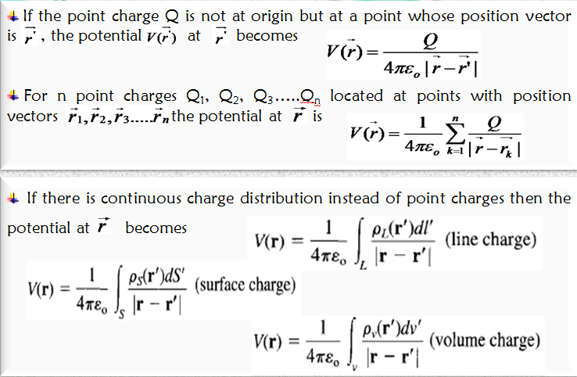
Electric Potential

Slide 21
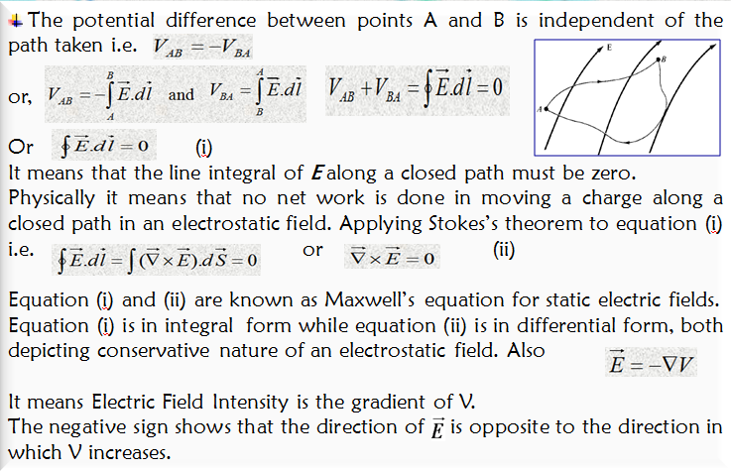
Relationship between E and V

Slide 22
Electromagnetic Theory
Medical diagnosis; electrical activity of organs [eyes, ears and stomach]
Industry; paint spray, Electro deposition, separation of fine particles.
Agriculture; sort seeds, moisture content of crops etc

